Slide 1
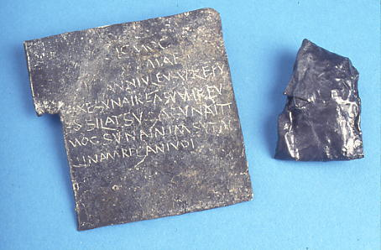
Curse tablets in the Roman Baths
Notes:
These can be found in the ‘Worshipping the Gods’ section of the museum as well as in the corridor by the sacred spring.
The museum’s interactive displays are particularly good for explaining how and why curses were used.
If this presentation is projected onto a Whiteboard, teachers and students can identify the individual words on the curse tablets using coloured marker-pens.
The final slide is designed to be printed out as a reference sheet, and students may like to use the table of letter forms for creating their own curses in either English or Latin.

Slide 2
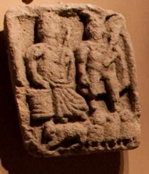
Stolen items mentioned on the curses:
A Caracalla, or hooded cloak, is mentioned on two of the curses. (‘Caracalla’ was the nickname of the Emperor Antoninus who ruled from 211-17 A.D.)
The wearing of this cloak was associated with Britain, and we know that they were made in Britain and exported around the Roman Empire.
Genii Cucullati “cloaked and hooded gods” were worshipped throughout the Celtic world and altars to these little gods – in groups of three – have been found in many sites.
This carved altar shows the Celtic goddess Rosmerta with the Roman god Mercury standing above an animal and three Genii Cucullati (at the bottom right of the carving).
Rosmerta and Mercury are often shown together and can be recognised by Rosmerta’s bucket-like container and Mercury’s wand and wings.
Other items include
different types of cloaks: (laena, pallium sagum), a woman’s cape (mafortium),
a pair of gloves (manicilia), four ordinary tunics (tunica), a tunic for use after bathing
(balnearis), a paxsa balnearis (probably Vulgar Latin for tunica pexa – a soft woollen garment), and various rugs and blankets.
Notes:
In 1979-80, 130 curse tablets were found in the Sacred Spring, adding to the two (including the Vilbia curse, C1) known from the 19th century.
They are written in various scripts, but no two are in the same handwriting.
Most are cursing a thief, and the articles which have been stolen suggest that the curse writers were not wealthy and could not afford to pay a slave (capsarius) to guard their property while they were in the bath-house.
More than 140 names are recorded on the tablets. Evidence from the handwriting and the style of people’s names suggests that the curses mostly belong to the late 2nd to 4th centuries A.D.
It was believed that writing on lead tablets could influence the actions or welfare of people by supernatural means. Tacitus describes how curses contributed to the unexpected death of Germanicus, a relative of the Emperor Tiberius, in A.D. 19 (Annals ii 69).
Defixio (a curse) comes from the Latin verb defigere = ‘to fasten, fix’.
This word does not appear on the Bath curse tablets, but we find the words devotio, ex[s]ecratio and donatio.
The tablets might also include otherwise meaningless ‘magic’ words such as bescu, berebescu or bazagra, which were thought to add potency to the curse (a bit like a magician saying abracadabra or hocus pocus!)
We do not know whether the curse tablets were successful in identifying and punishing culprits, but the fact that the practice continued for 2 centuries suggests that people believed it worked!
Names of possible offenders are suggested to the goddess and she is asked to exact the goods or their equivalent in blood from the culprit.

Slide 3
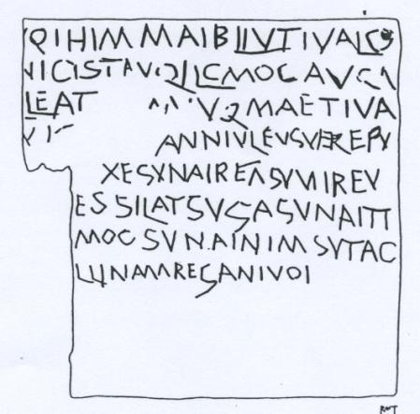
MAIBLIV
This curse is the inspiration for stories in the Cambridge Latin Course, but it is not really likely that it refers to a woman! ‘VILBIA’ is more likely to be an object. Dr R S O Tomlin who translated the curses, suggests fibula - a brooch.
The capital letters resemble scripta monumentalis, but they are not formed well.
It is made from a lead alloy sheet: a strip has been cut from the left side later, so the message is incomplete.
The word order is correct: read from left to right, but each word is written backwards.
C1
The first three and a half lines are written with a blunt stylus point. The remainder is written with a sharper implement, perhaps by a different person.
NB The word ‘vilbia’ is written ‘vilbiam’ because this is how the Latin language shows that it is the OBJECT of its sentence. The word is in the Accusative case.

Slide 4
qu[i] mihi vilbiam in[v]olavit
sic liquat com[o] aqua …..
qui eam [invol] avit
… Velvinna Ex[s]upereus
Verianus Severinus
Augustalis Comitianus
Minianus Catus
Germanill[a] Iovina
C1
May he who has stolen Vilbia become as liquid as water ..who has stolen it (or her) Velvinna, Exsupereus, Verianus, Severinus, Augustalis, Comitianus, Minianus, Catus, Germanilla, Jovina.
Since the list of possible suspects includes women’s names, this makes the idea of Vilbia being a girl more unlikely.

Slide 5
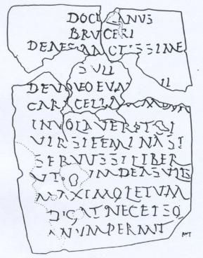
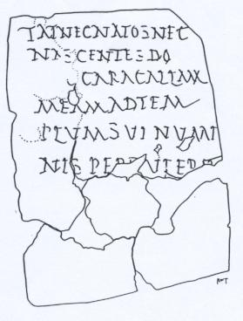
This double-sided curse is written on a lead alloy sheet in a calligraphic script resembling ‘bookhand’, which was normally used on papyrus with a soft pen nib to give thick and thin strokes.
It is elegantly laid out, with a central heading like a stone inscription.
The style of writing and inclusion of the patronymic Bruceri (son of Brucerus) suggest a date in the 2nd century.
C2a
C2b
It refers to the theft of a hooded cloak or
CARACALLA.
The alternatives
si vir si femina, si servus si liber “if man if woman, if slave if free”
seem to be a formula to ensure that no-one is excluded from the goddess’s search for the culprit!

Slide 6
C2a
C2b
Docilianus Bruceri deae sanctissim[a]e Suli devoveo eum [q]ui caracallam meum involaverit si vir si femina si servus si liber ut [..]um dea Sulis maximo letum [a]digat nec ei somnum permittat nec natos nec nascentes do[ne]c caracallam meam ad templum sui numinis per[t]ulerit
Docilianus [son] of Brucerus to the most holy goddess Sulis. I curse him who has stolen my hooded cloak, whether man or woman, whether slave or free, that .. the goddess Sulis inflict death upon .. and not allow him sleep or children now and in the future, until he has brought my hooded cloak to the temple of her divinity.

Slide 7
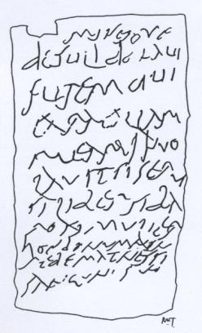
This cast alloy sheet, which has been hammered flat, has been inscribed with a stylus in a 3rd century A.D. script.
C3
It is again bemoaning the loss of a caracalla – a hooded cloak. (Notice that the word ends in ‘m’ to show that it is the object of the sentence).
The alternatives si se[r]vus si liber si baro si mulier “if slave if free, if man if woman” seem to be a common formula.
The table of New Roman Cursive forms on the final slide can help with deciphering some of these letters, but some of them are in the Old Roman Cursive style.

Slide 8
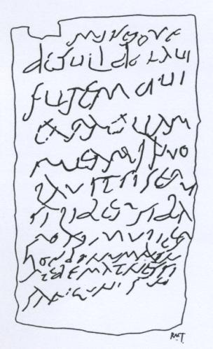
Minerv[a]e
de[ae] Suli donavi
furem qui
caracallam
meam invo-
-lavit si ser[v]us
si liber si ba-
-ro si mulier
hoc donum non
redemat nessi
sangu[i]n[e] suo
N.B. vulgar spelling of ‘Minervae’
(‘ae’ and ‘i’ endings mean ‘to’ in Latin, and are known as the DATIVE case).
‘involavit’ spans two lines
N.B. vulgar spelling of ‘serus’ for servus
‘baro’ must be a Celtic word.
N.B. vulgar spelling of ‘nessi’ for nisi
C3
To Minerva the goddess Sulis I have given the thief who has stolen my hooded cloak, whether slave or free, whether man or woman. He is not to buy back this gift unless with his own blood.

Slide 9
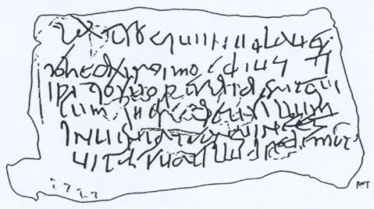
The table of NRC letter forms on the final slide can help with deciphering this curse.
It is made from an irregular rectangle cut from a thick sheet of tin which has been hammered flat.
It is written with a blunt stylus and was produced by a practised scribe.
C4
The second line has been written from right to left.
Perhaps the writer intended it to be written as boustrophedon text (where alternate lines are written reversed) but forgot at the fourth line!
Deus (‘god’) does not seem to apply to Sulis Minerva. The Roman gods Mars and Mercury appear on some other curses at Bath.

Slide 10
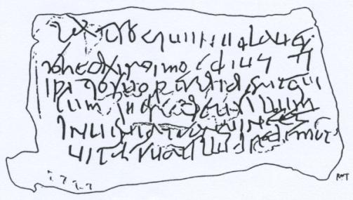
C4
execro qui involaver-
-it qui Deomiorix de hos-
-[i]pitio suo perdiderit qui-
-cumque r[es] deus illum
inveniat sanguine et
vitae suae illud redemat
For the Latin to be correct, Deomiorix should have put his name into the ACCUSATIVE case: ‘Deomiorigem’ to show that he is the object of the verb.
Remember that the second line is written backwards!
I curse (him) who has stolen, who has robbed Deomiorix from his house. Whoever (stole his) property, the god is to find him. Let him buy it back with his own life.

Slide 11
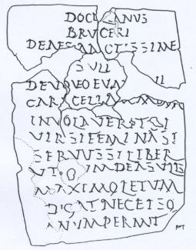
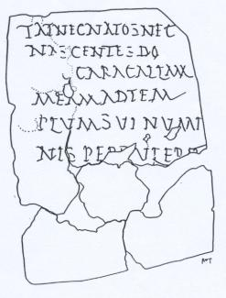
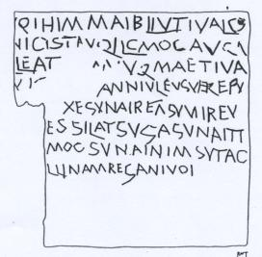
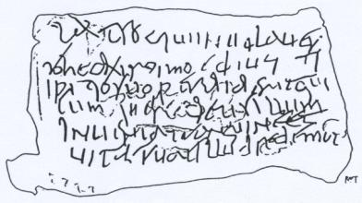
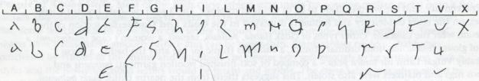
Curse tablets from Bath
C1
C2a
C2b
C3
C4
New Roman Cursive Letter forms : as used in C4 and some of C3.

Slide 12
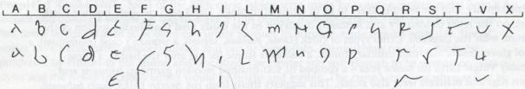
Create a curse
Name ………………………………………………………..
Decide on the crime which has been committed – someone has stolen something precious.
Dedicate the person to the goddess.
Decide on the appropriate action for the goddess to take.
Give a list of possible suspects.
Add a few magic words such as BESCU BEREBESCU.
Write each of your words backwards.
Transliterate into New Cursive Roman letter forms, using the chart above.
Add a design, perhaps of the goddess chasing the criminal.

